Slide 1
Applied OSINT For Politics: Turning Open Data Into News

Slide 2
The Political OSINT Process
Target
Package
Defend
Verify
Research
Release

Slide 3
Your Politics Do Not Matter
Document Everything
Tell A Story, Don’t Be The Story
Know What You Don’t Know

Slide 4
Order Of Attention
Reprehensible
Hypocritical
Immoral
Illegal
Unethical

Slide 5
OSINT Sources For Politics
Campaign Finance (contributions, disbursements)
Personal Financial Disclosure/Statements of Economic Interest
Legislative Office Disbursements
Business Registrations
County Property Records
Voter Registration/Voting History
FOIA/Public Records Requests

Slide 6
What You Need To Consider When You Find Something
What will be the impact of what you’ve found?
Who is the target audience?
What do they believe? Who will they believe?
Why will they care?
Are you willing to stake your public reputation on this?

Slide 7
Ways To Release OSINT
Journalist
Interested Party
Subject
Opponent
Outside Group
Local
National
Investigative
Partisan
Self Publish

Slide 8
Packaging OSINT For News
Context, Honesty, Story

Slide 9
Pitching A Story
Know the reporter
Start small
Be prepared
Don’t over-promise
Be honest

Slide 10
Self-Publishing
Stick to the story (shorter the better)
Be prepared to become the story
Charts! Visualizations! Infographics!
You can still pitch the story to journalists
Play Into archetypes, expectations, and priors
Balance humor with the seriousness of the information

Slide 11
OSINT In Action

Slide 12
Selling Out Before The Financial Crisis
What Happened: A member of the United States Congress received was officially alerted of the impending financial crisis, and sold off significant stock holdings before those warnings were made public.
Tools:
News Reports
Financial Disclosure
Legislative Records

Slide 13

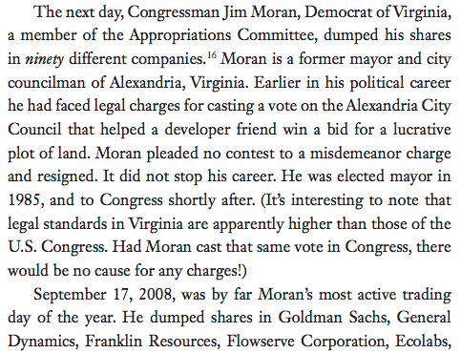
Selling Out Before The Financial Crisis

Slide 14
Family Money Laundering Campaign Contributions
What Happened: The family of a member of the United States Congress illegally loaned the member hundreds of thousands of dollars for his political campaign, violating campaign finance laws.
Tools:
Financial Disclosure
Campaign Finance Report

Slide 15
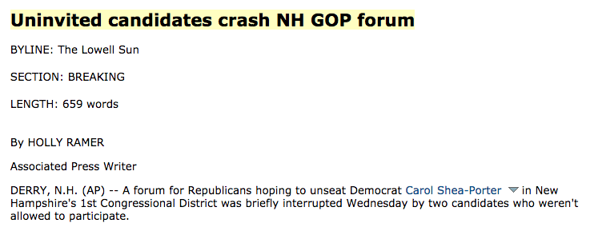
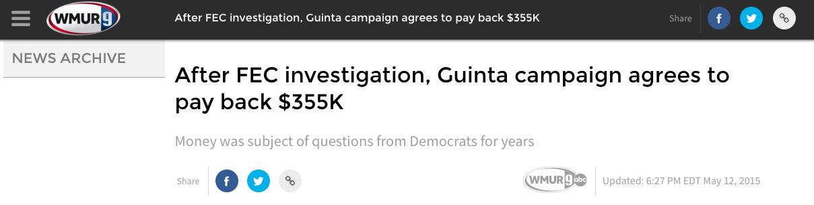
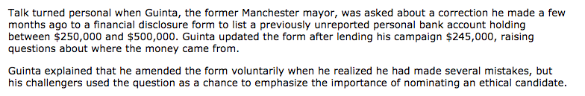
Family Money Laundering Campaign Contributions
August 2010
May 2015

Slide 16
How To Save $300,000 On A Home
What Happened: A U.S. Senator purchased a brand new home at a steep discount from a major campaign donor.
Tools:
Financial Disclosure
Campaign Finance Reports
County Registrar of Deeds
Campaign Finance Records

Slide 17



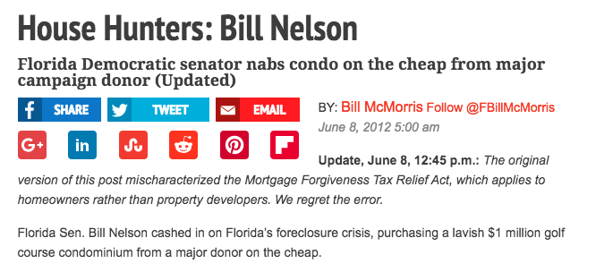
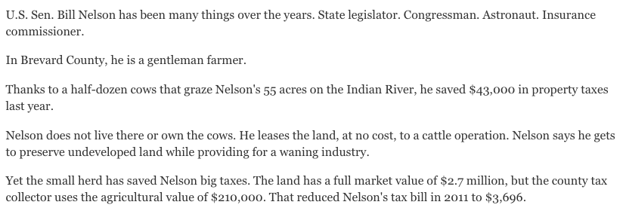
How To Save $300,000 On A Home

Slide 18
Downton Abbey On Capitol Hill

Slide 19

Downton Abbey On Capitol Hill

Slide 20
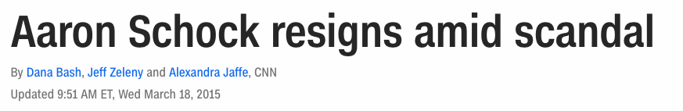
Downton Abbey On Capitol Hill

Slide 21
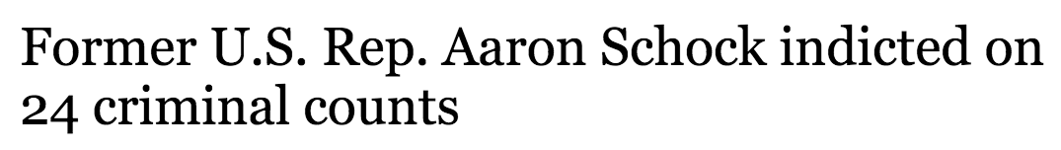
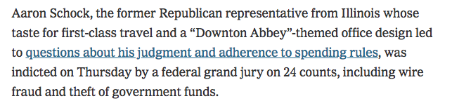
Downton Abbey On Capitol Hill

Slide 22
Downton Abbey On Capitol Hill
What Happened: A member of Congress fraudulently spent taxpayer and campaign money to enrich himself and support his lifestyle. And, like, a bunch of other bad stuff, too.
Tools:
Legislature Disbursements
Financial Disclosure
Campaign Finance Reports
Business Registration
Property Records

Slide 23
Voter Fraud Is Real
What Happened: Voter fraud, although difficult to prove, does occur and has cost several politicians their careers.
Tools:
County voter registration records, voting histories
Property tax exemptions

Slide 24
Other OSINT Applied To Politics
Resume Exaggeration: stolen valor and resume inflation
Straw Donors: lower wage workers donating large sums to same political as the company CEO
Plagiarism: matching unique phrases in writing authored by a public figure (speeches, too)
Planes And Yachts: tracking movements of the wealthy
Web Research: DNS and development

Slide 25
Public Records Requests!
Don’t be afraid to ask a government entity for a document, they almost always MUST give it to you.
Ask for a specific document, created in a specific date range
Document all communication
Know the law and the public history (similar requests, references to documents)
Be prepared to spend some money
If you hit a wall, enlist help (journalists, Muckrock)

